Slide 1



Data Structure
&
Algorithm
Class X
lab 9

Slide 2

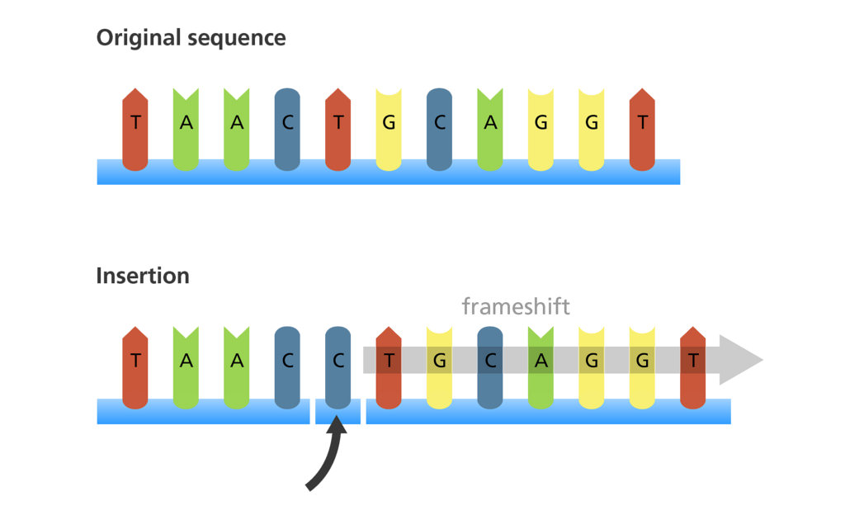
Insertion Sort
an in-place comparison-based sorting algorithm

Slide 3
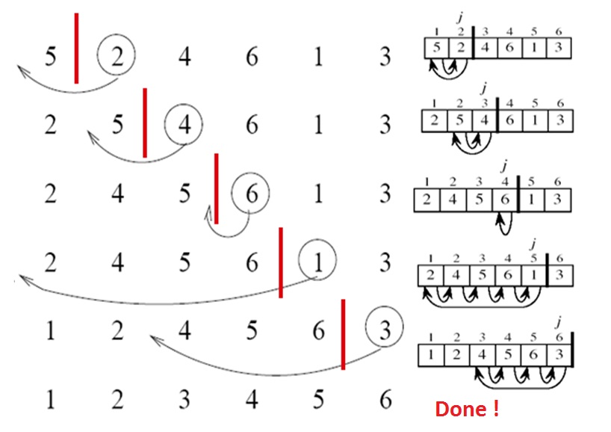
Example 1

Slide 4
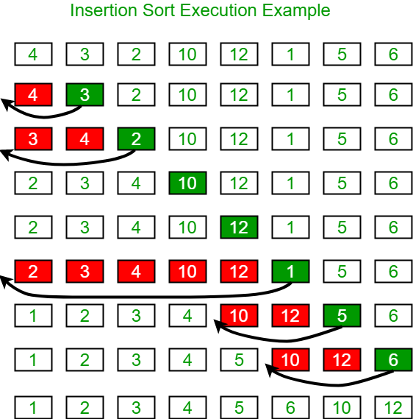
Example 2

Slide 5
Algorithm
Step 1 − If it is the first element, it is already sorted. return1; Step 2 − Pick next element Step 3 − Compare with all elements in the sorted sub-list Step 4 − Shift all the elements in the sorted sub-list that is greater than the value to be sorted Step 5 − Insert the value Step 6 − Repeat until list is sorted

Slide 6


